Slide 1





Slide 2

Project Lead : Bharani Kumar Depuru
Director & Co-Founder at Innodatatics | Chief Data Scientist
https://www.linkedin.com/in/bharanikumardepuru/
Team Leader: Sushmitha Pasupaleti
Associate Data Scientist at 360DigiTMG
Team Member : Oruganti Amsu Madhu Deepika
Data Scientist Intern at Innodatatics
https://www.linkedin.com/in/madhu-deepika-oruganti-5158b0193/

Slide 3
Contents
Business Problem
Project Overview and Scope
Data Dictionary
Exploratory Data Analysis
Data Preprocessing
Data Visualization
Project Architecture
Model Building
Model Deployment strategy
Final Output
Conclusion
Challenges
Notes:
Change

Slide 4
Business Problem
Business Problem: A notable surge in bounce rates is causing dissatisfaction among patients.
Business Objective: Aim to minimize bounce rates. Business Constraint: Keep inventory costs at a minimum.
Success Metrics
Business Success Metric: Achieve a minimum 30% reduction in bounce rates.
Economic Success Metric: Drive a revenue increase of at least 20 lacs INR through the effective reduction of bounce rates.

Slide 5
Project Overview and Scope
Project Overview:
The project addresses a critical challenge in the healthcare system, focusing on the significant increase in bounce rates, which is adversely affecting patient satisfaction. The rising bounce rates indicate patients leaving the healthcare system dissatisfied before completing their intended actions or transactions.
Scope:
Analyze historical bounce rates and key contributing factors.
Explore and preprocess relevant data for accurate forecasting.
Implement SARIMAX models for future bounce rate predictions.
Optimize inventory levels to align with forecasted demand.
Enhance patient experience through streamlined operations.
Define success metrics: 30% reduction in bounce rates, 20 lacs INR revenue increase.
Continuous monitoring, feedback, and iterative improvements.

Slide 6
Data Dictionary
Name of the Feature | Description | DataType
1. Type of Sales | Type of sale of the drug(sale/Return) | Categorical(Binary)
2. Patient_ID | ID of a Patient | Numeric
3. Specialisation | Name of Specialisation | Categorical
4. Dept | Pharmacy Department | Categorical
5. Dateofbill | Date of purchase | Time-series-data
6. Quantity | Quantity of drug sold | Numeric
7. ReturnQuantity | Quantity of drug returned by the patient | Numeric
8. Final_Cost | Final cost of the drug includes quantity | Continous
9. Final_Sales | Final sales amount | Continuous
10. RtnMRP | MRP of the returned drug includes quantity | Numeric
11. Formulation | Type of drug formulation | Categorical
12. DrugName | Generic name of the drug | Categorical
13. SubCat | Subcategory to the category of drugs | Categorical
14. SubCat1 | Subcategory condition to the category of drugs | Categorical

Slide 7
Exploratory Data Analysis [EDA]
Business Insights:
Uncleaned Data:
Higher Variability:
Elevated variance, standard deviation, and range indicate data inconsistencies.
Skewed Distributions:
Skewed and peaked distributions hint at potential irregularities.
Central Tendency Discrepancies:
Differences between mean and median suggest potential outliers' influence.
Reliability Concerns:
Concerns about data reliability due to higher variability and skewed distributions.
Cleaned Data:
Reduced Variability:
Lower variance, standard deviation, and range indicate a more consistent dataset.
Normalized Distributions:
Lower skewness and kurtosis values suggest normalized distributions.
Aligned Central Tendency:
Improved alignment between mean and median enhances data balance.
Enhanced Reliability:
Reduced variability and normalized distributions enhance dataset reliability
Notes:
EDA is used for seeing what the data can tell us before the modeling task.
Change

Slide 8
Statistical Insights:
Uncleaned Data:
Higher mean, variance, standard deviation, range, skewness, and kurtosis values.
Increased inconsistencies, variability, and potential outliers.
Cleaned Data:
Lower mean, variance, standard deviation, range, skewness, and kurtosis values.
More consistent and normalized distributions.
Reduced variability and potential biases for enhanced reliability.

Slide 9
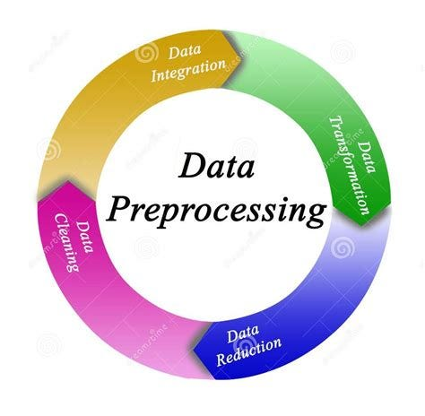
Data Preprocessing
Data preprocessing steps include:
Imputing Missing Values
Removal of Outliers
Data Normalization
Handling Categorical Data
Feature Scaling
Dealing with Duplicates
Data Transformation
Handling Date-Time Data
Addressing Skewness
Handling Imbalanced Data
Notes:
Keep observations

Slide 10
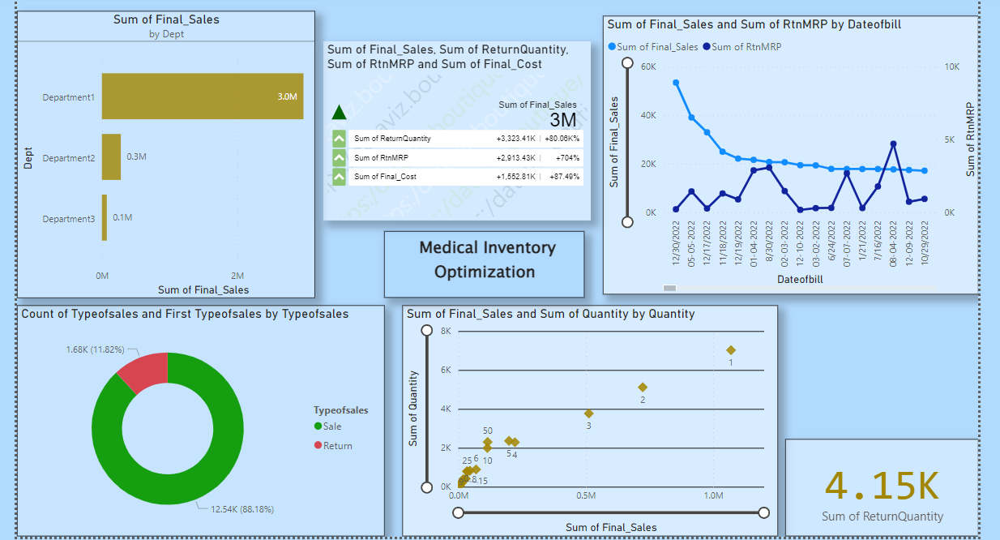
Data Visualization
Notes:
Add graphical

Slide 11
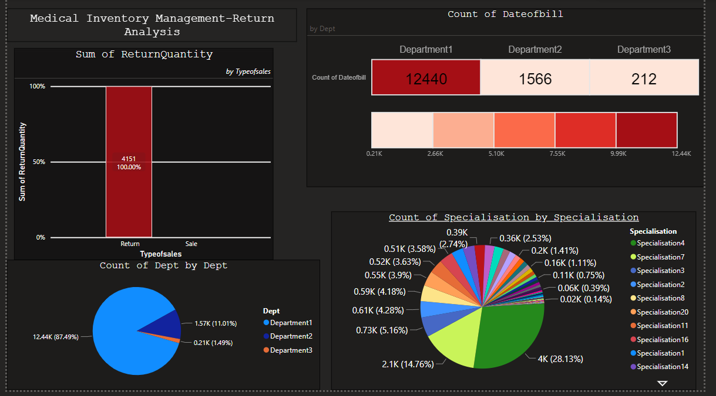

Data Visualization- Return analysis

Slide 12
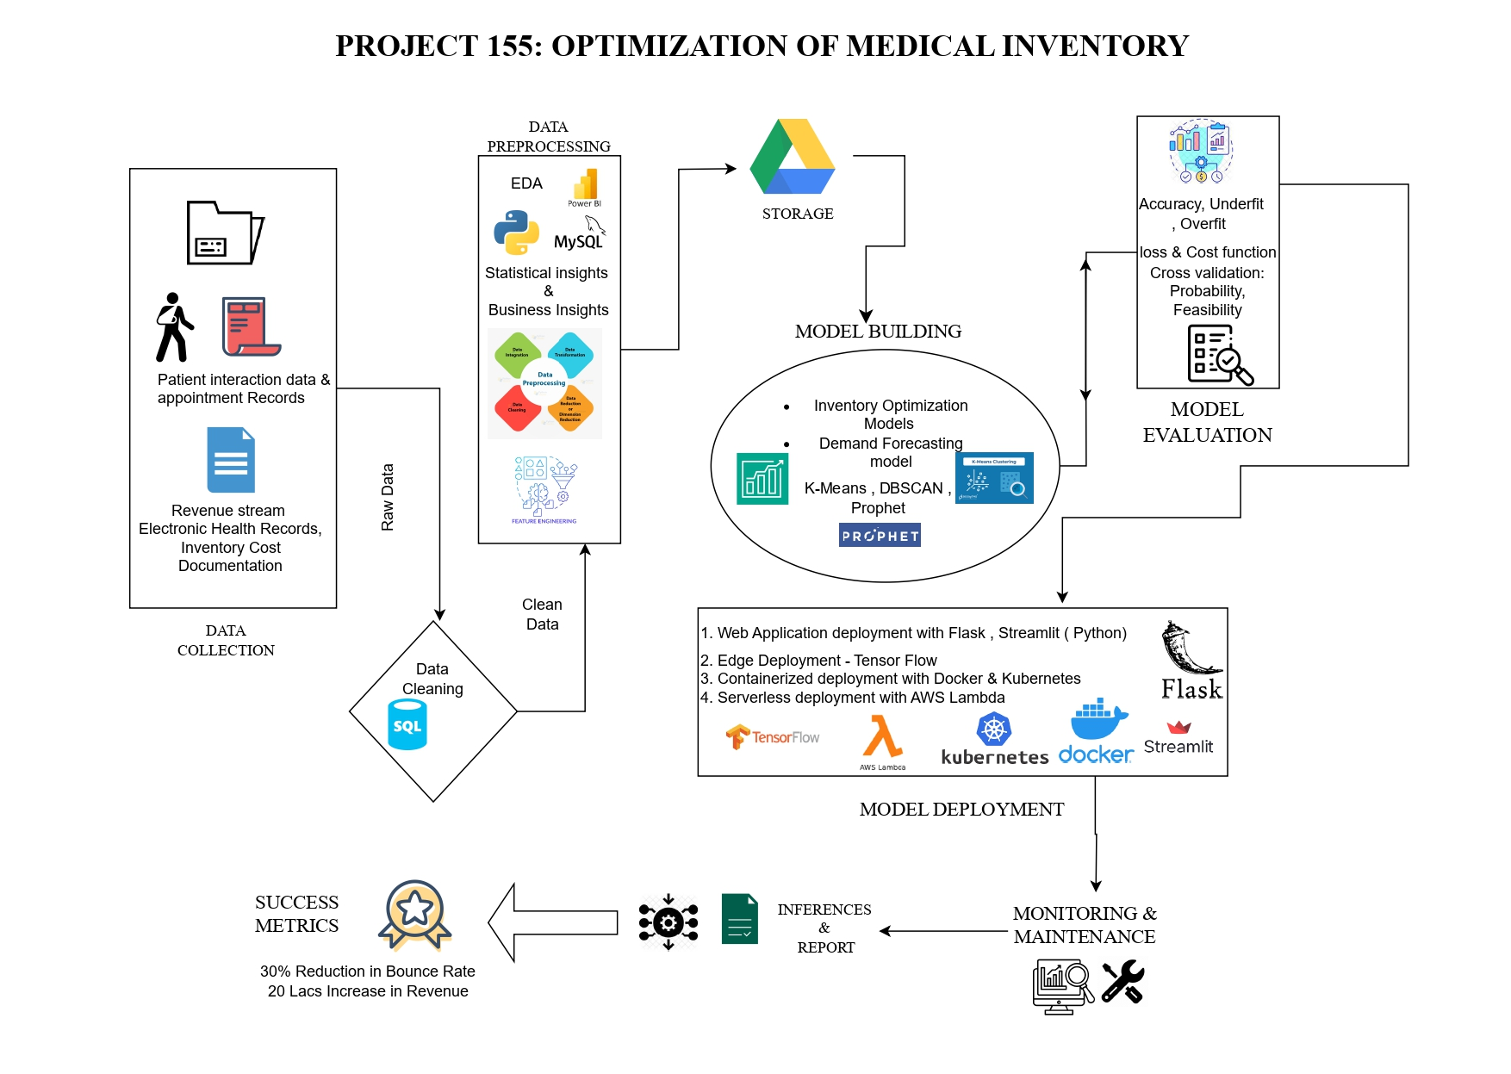

Project architecture

Slide 13

MODEL BUILDING
Selected Model: SARIMAX
Reasoning:
Among the models considered, SARIMAX demonstrated a competitive MAPE of 1.16%, indicating accurate forecasting performance.
SARIMAX incorporates exogenous variables, allowing it to capture external factors influencing the time series data.
The model's ability to handle seasonality and trends makes it well-suited for our medical inventory forecasting application.
Key Features of SARIMAX for Time Series Forecasting:
Seasonal Decomposition: Captures cyclic patterns and seasonality in the data.
Exogenous Factors: Considers external variables influencing the time series.
Autoregressive and Moving Average Components: Accounts for historical data and past trends.
Dynamic Forecasting: Adapts to changes in the time series dynamically.
SARIMAX emerges as the preferred choice for its robust performance, incorporating both historical trends and external factors for accurate and dynamic medical inventory forecasting.
MODEL | MAPE %
ARIMA | 1.06%
SARIMA | 1.12%
SES (Simple Exponential Smoothing) | 1.10%
RNN (Recurrent Neural Network) | 1.72%
LSTM (Long Short-Term Memory) | 2.214%
Moving Average (MA) | 6.8%
GRU (Gated Recurrent Unit) | 81.28%
SARIMAX | 1.16%

Slide 14


MODEL DEPLOYMENT - STRATEGY
Tool: Streamlit
Duration: Forecasting for 15 weeks
Data Preprocessing: Integrated within Streamlit app for real-time processing.
Predictions: Transparent display of forecasted values and dates.
Visuals: Enhanced comprehension with line charts and histograms.
Accessibility: Deployed on a server for wider accessibility.
Streamlit ensures user-friendly interaction with the SARIMAX model, providing transparent and visually appealing forecasts for effective decision-making.

Slide 15
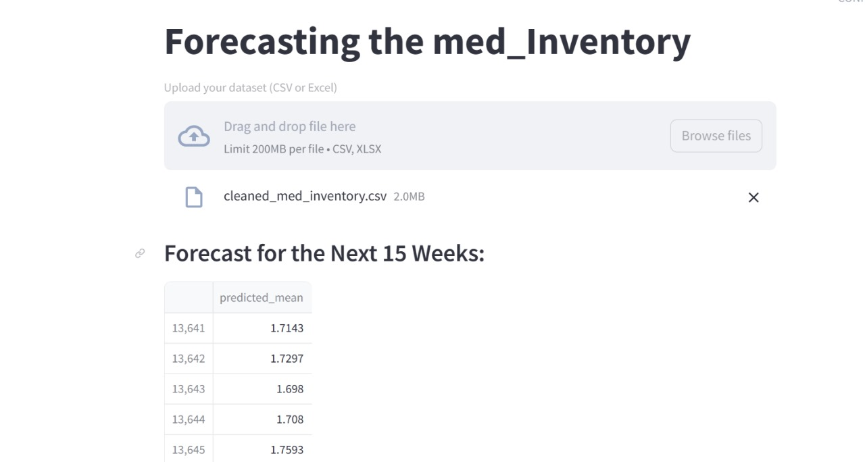
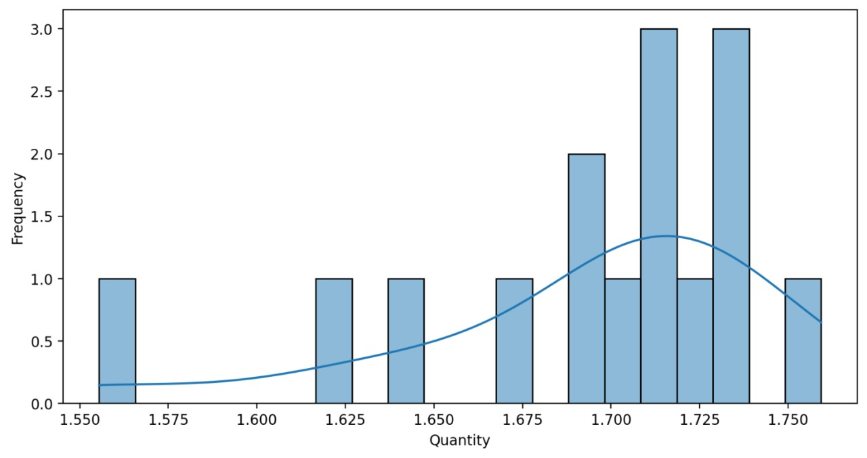

SCREEN SHOT OF THE OUTPUT

Slide 16
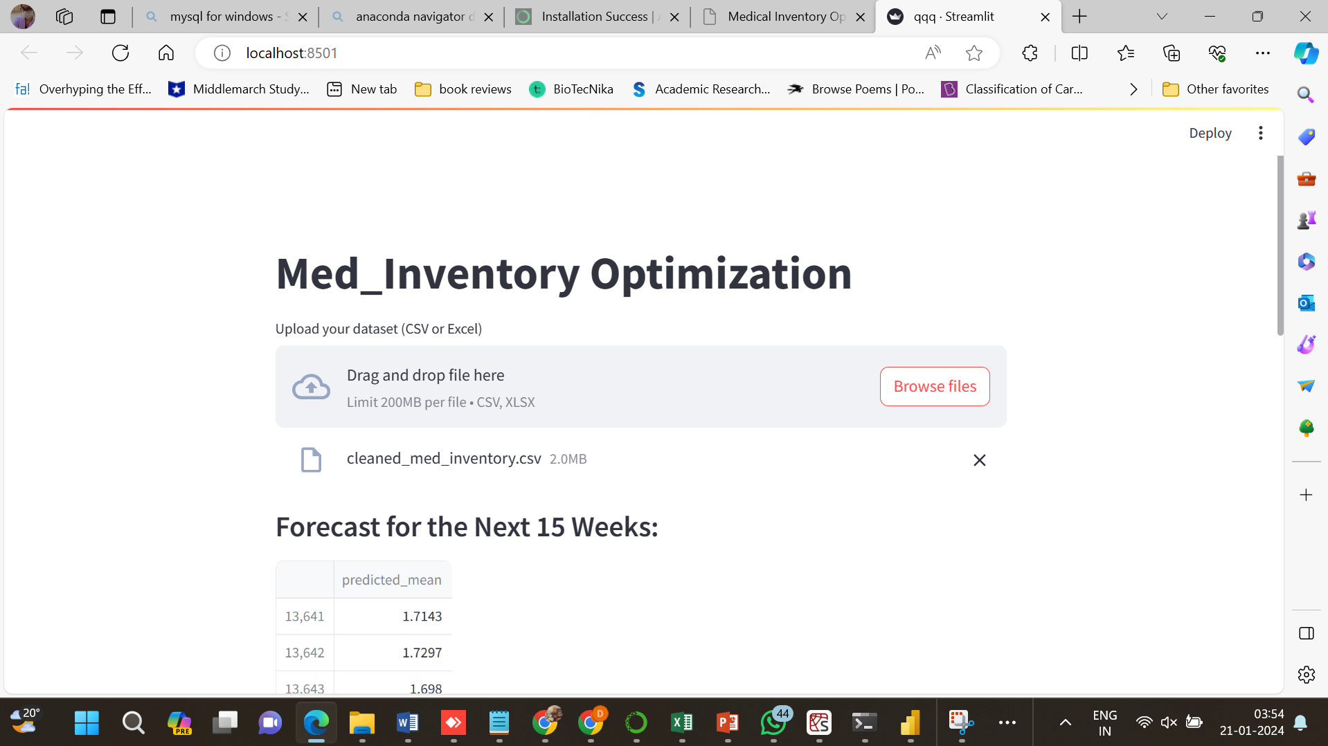
SCREENSHOT OF OUTPUT

Slide 17
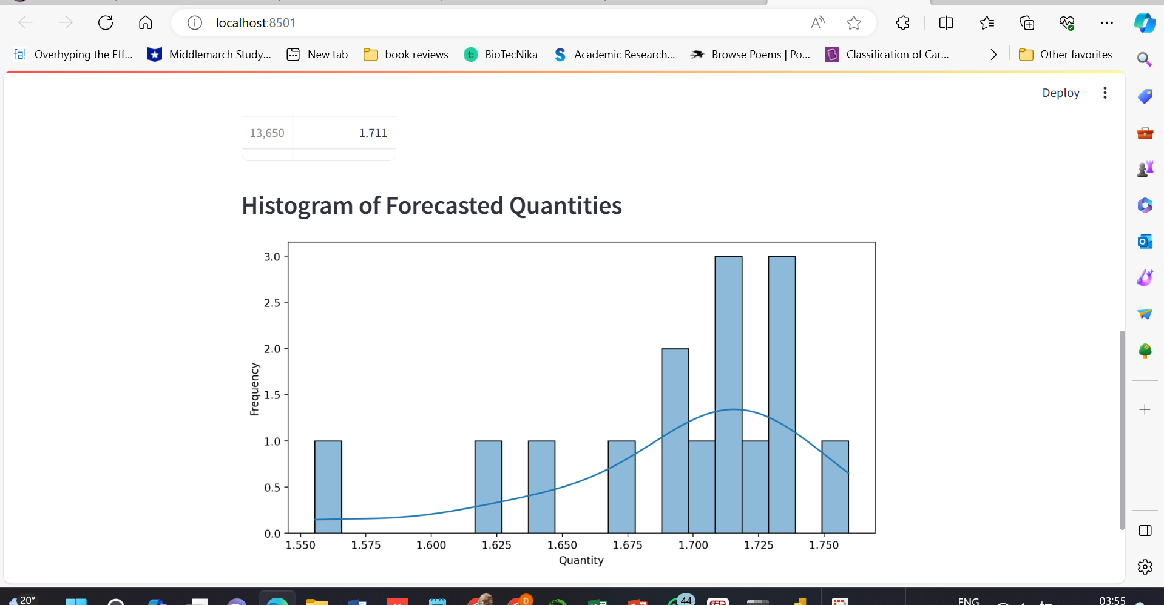

Slide 18
Conclusion
The presented forecasted values for the upcoming 15 weeks reveal promising insights into the effectiveness of the implemented strategies aimed at minimizing bounce rates and optimizing inventory costs
The forecasted values suggest a positive trend, indicating potential success in addressing the challenge.
Although not directly addressed in the provided data, successful bounce rate reduction indirectly contributes to operational efficiency, aligning with cost optimization
While the forecasted values do not explicitly quantify the percentage reduction, the positive trend suggests a step towards achieving the business success metric. Economic success is anticipated through improved patient satisfaction.
The forecasted values provide optimism, indicating a positive trajectory towards achieving the project's defined goals. Continuous monitoring and assessment will be crucial to validate the actual impact on bounce rates and economic success. Further data analysis and stakeholder feedback will enhance the depth of our understanding and validate the success of the implemented strategies.

Slide 19
Challenges
Data Quality:
Handling missing values and outliers posed initial data quality challenges.
Model Selection:
Evaluating multiple models for time series forecasting required careful consideration.
Streamlit Integration:
Navigating Streamlit and ensuring seamless integration with the SARIMAX model.
Server Resources:
Allocating sufficient resources for hosting and deploying the Streamlit app.
Interpretability:
Communicating complex forecasting results in an understandable manner for stakeholders.
Real-time Forecasting:
Ensuring real-time updates and forecasts for the upcoming 15 weeks.

Slide 20

Queries

Slide 21


